Slide 1

Cyclistic Case Study
Mohamed Salat Gelle – April 2024

Slide 2
Business Task
Analyse usage differences between casual riders and annual members of Cyclistic bikes in Chicago to devise a marketing strategy for converting casual riders into annual members.
Single-ride passes and Full-day passes
Annual memberships

Slide 3
Tools Used
Excel/Sheets – Analysing data, Cleaning data, Checking data integrity
SQL – Formatting and transforming data
R – Cleaning, Transforming data into samples and Visualizing data
Tableau – Creating Visualizations

Slide 4
Data Preparation and Analysis
Calculated Mean and Max ride length, Mode of day of week
Created pivot tables to view summary of the data
Cleaned and combined all csv files into a whole year view

Slide 5
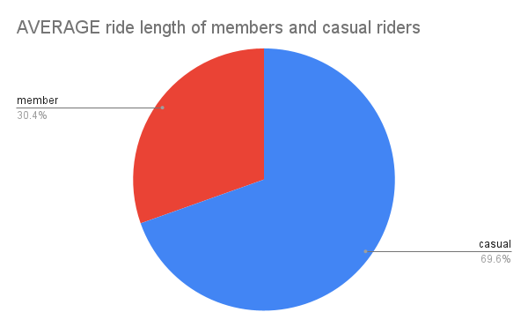
Data Visualization
Casual riders have a higher average ride length than annual members

Slide 6
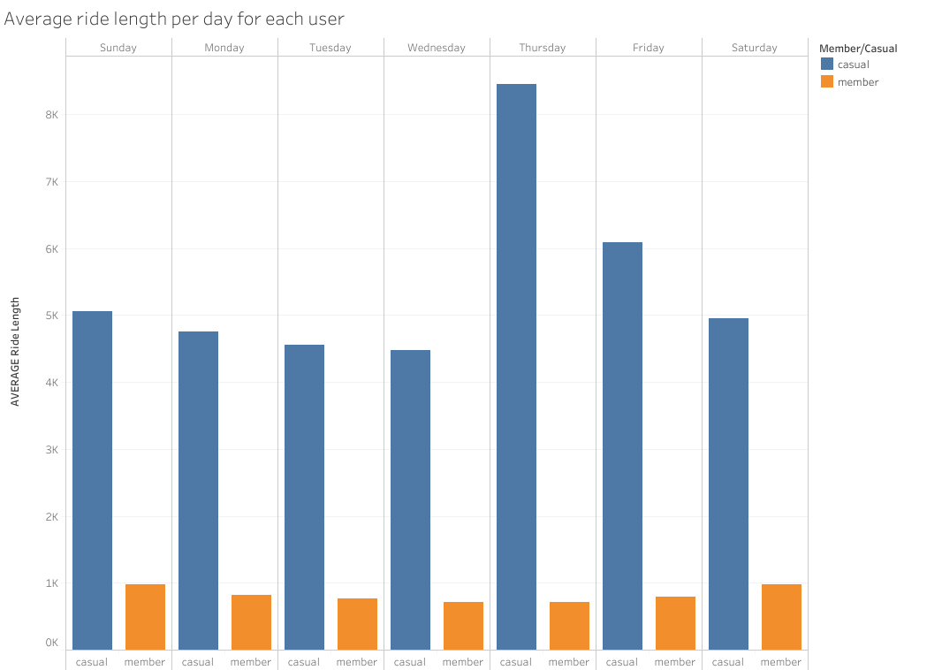
Data Visualization
Casual riders have a high average cycling time on Thursdays

Slide 7
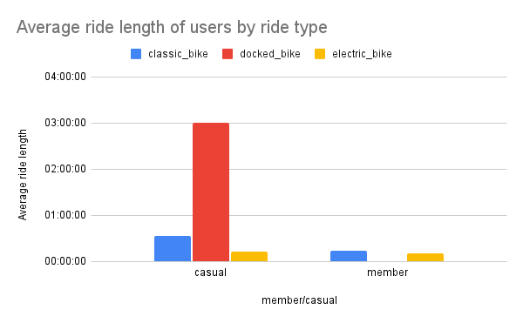
Data Visualization
Casual riders prefer docked bikes while annual member prefer classic bikes

Slide 8
Recommendations
Flexible Membership Plans with Incentives: Given that casual riders often engage in longer rides, Cyclistic can introduce annual membership plans that offer benefits specifically tailored to accommodate their preferences. For example, Cyclistic could offer an "Unlimited Ride Pass" as part of its annual membership package

Slide 9
Recommendations
Exclusive Weekly Offers:To capitalize on casual riders' high average cycling times on Thursdays, Cyclistic can introduce exclusive weekly offers specifically targeted at casual riders. For instance, Cyclistic could launch a "Thursdays Only" promotion where casual riders receive a significant discount on annual membership purchases made on Thursdays.

Slide 10
Recommendations
Personalized Bike Options with Membership: Recognizing the preference differences between casual riders and annual members regarding bike types, Cyclistic can offer personalized bike options as part of its annual membership package to cater to the diverse needs of casual riders.

Slide 11
Data Source
https://divvy-tripdata.s3.amazonaws.com/index.html
Data used was from 2023 ranging from 202301-divvy-tripdata to 202312-divvy-tripdata

Slide 12


